Slide 1
Approximation and Precomputation
COMS-6998 HDI

Slide 2
WARNING: Math Involved!
Related Class: COMS-4995 Advanced Algorithms
Markov, Chebyshev, Chernoff, Bernstein, Cauchy-Schwarz, Johnson Lindenstrauss……….

Slide 3
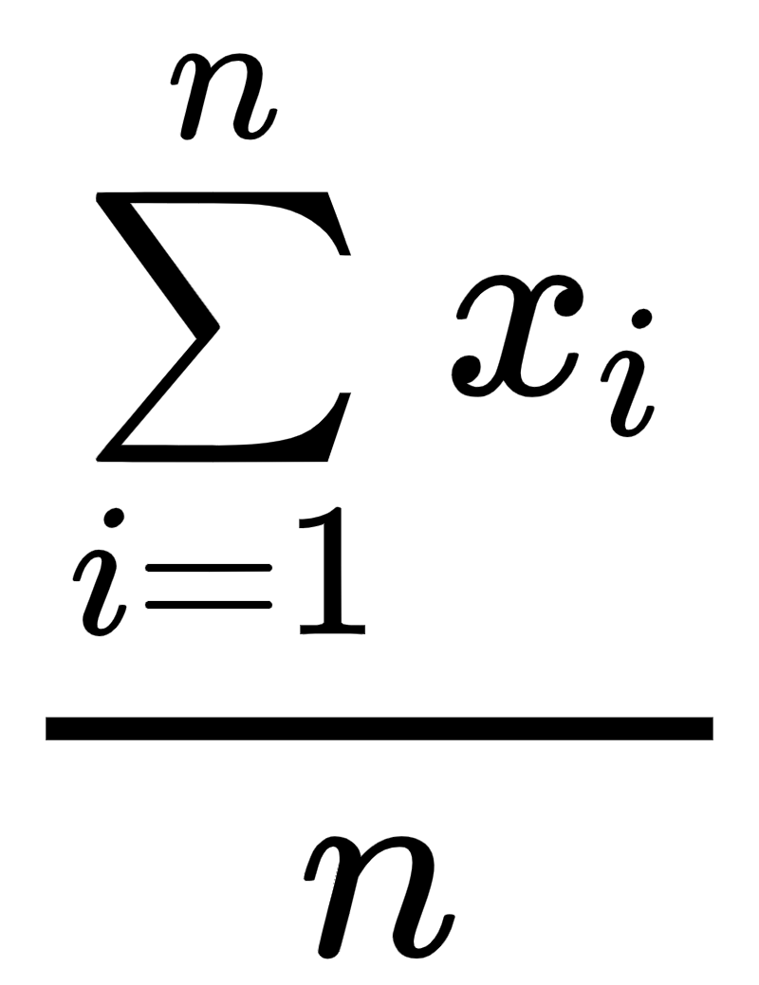
Problem: Fast Operation is no Longer Fast Enough
Consider Sample mean: which is a linear time operation. (pretty fast)
10¹⁰ operations a second (Faster than today’s CPU),
10¹² rows: the execution takes at least 100 seconds!
Solution (Takeway): We can always use a smaller dataset with precomputed caching for an approximate measure close to the exact.

Slide 4
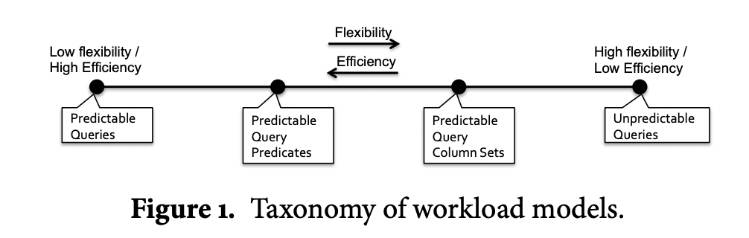
Presentation Flow - Workload Flow

Slide 5
Predictable Query
Fixed Query, almost no flexibility:
Mean of 1 column:
SELECT MEAN(S.AGE)
FROM Student S

Slide 6
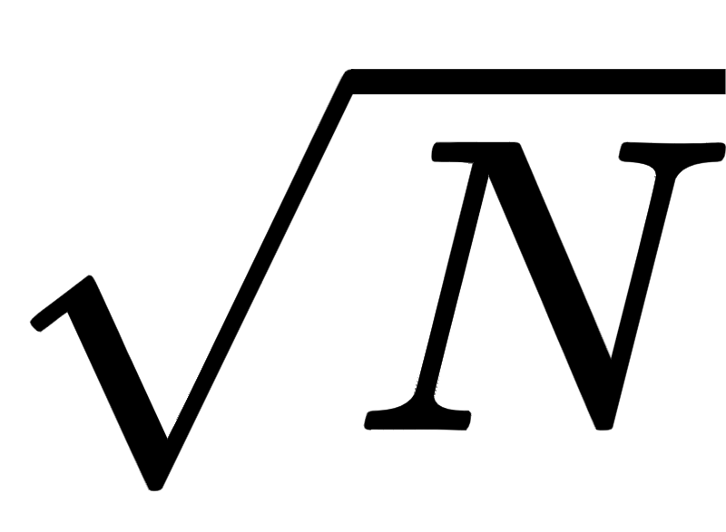
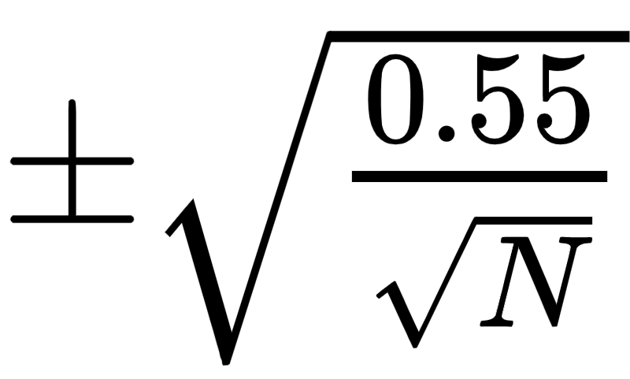
Predictable Query: Sample Mean of 1 Table.
Suppose a table saves values between 0 and 1, each row is independent:
Hoeffding Bound guarantees: if you random sample points, we have a 0.99 confidence interval of true mean between .
Performance Boost from the Motivation: we only use 10⁶ data now, and the probability that the approximation is within 0.0007 is 99%

Slide 7
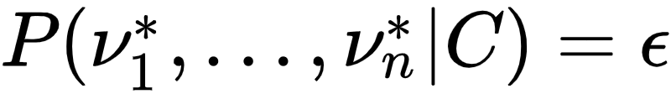
Predictable Query: PFunk-H
User have cognition error, which means any approximation that is within the same magnitude is freebie.
V denotes to True value, C denotes User’s Condition, epsilon denotes to a small deviation from the true value.
PFunk-H: Approximate Query Processing using Perceptual Models

Slide 8
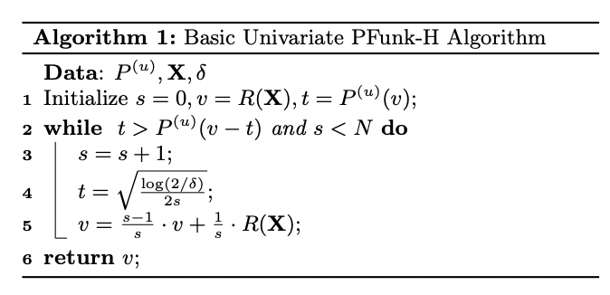
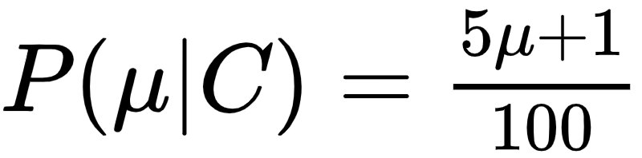
Predictable Query: PFunk-H
Visualizing one sample mean as a single bar plot:
Sample Mean Algorithm Analysis: Hoeffding Bound (H in PFunk-H)

Slide 9
Predictable Query Predicates
Optimize based on Query Keywords.
SELECT AVG(S.GPA)
FROM Student S JOIN Major M ON S.sid=M.sid
WHERE M.name =’mathematics’
GROUP BY S.AGE

Slide 10
Predictable Query Predicates - Join
Obtain IID sample of the join set is pretty hard: naively, you need to join first (pretty expensive), then sample with equal probability.
Ripple Join (Rounds Robin): Random sample each table and then join the random sampled tables.

Slide 11
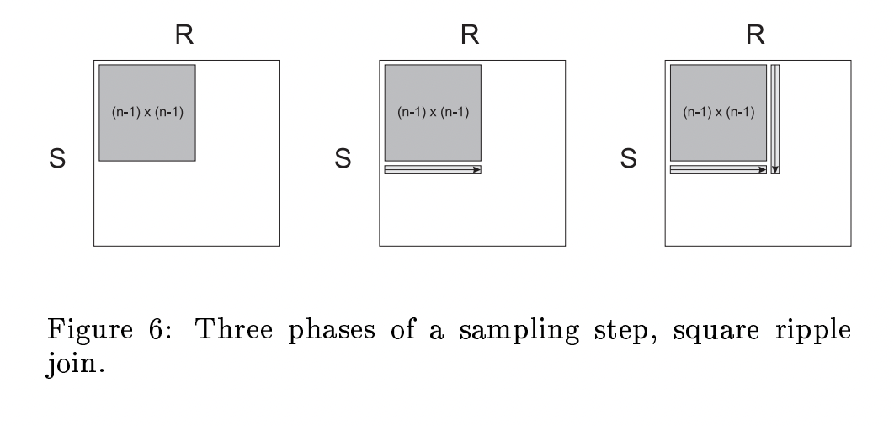
Ripple Join
Ripple Join for Online Aggregation

Slide 12
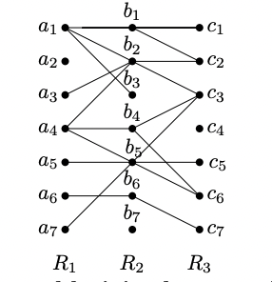
Empirically Better Technique: Wonder Join
Wonder Join: starting a sample table , perform a random walk of the join-link.
Wonder Join: Online Aggregation via Random Walks

Slide 13
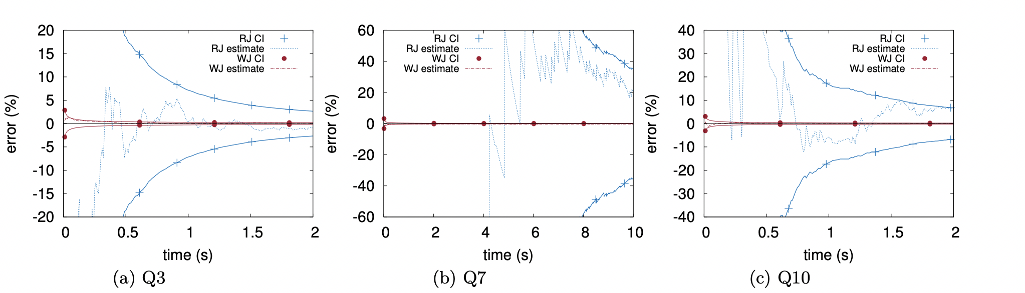
Wonder Join Optimization & Possible Improvement
Empirically, polynomial improvement on approximation convergence.

Slide 14
Wonder Join Issues
1: Null Foreign Reference slows the approximation convergence
2: Underrepresented column values may not appear in random walk.

Slide 15
Predictable Query Column Set
Optimization based on mostly queried (group/filter) columns:
Problem: balance between speed and space storage.
SELECT AVG(S.GPA)
FROM Student S JOIN Major M ON S.sid=M.sid
WHERE M.name =’mathematics’
GROUP BY S.AGE

Slide 16
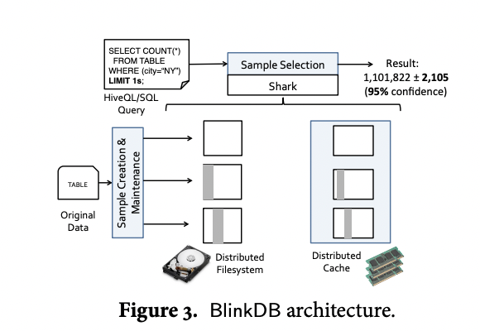
Blink DB
Column Selection
Sampling Approach
Distributed System

Slide 17
Sampling Approach - Stratified Sampling
Cap the value which has higher occurrence.
Sample 16 points:
x1 | x2 | x3 | x4 | x5 | x6 | x7 | x8
1 | 2 | 4 | 8 | 16 | 4 | 2 | 1
x1 | x2 | x3 | x4 | x5 | x6 | x7 | x8
1 | 2 | 2 | 2 | 2 | 2 | 2 | 1
Note: Solves underrepresentation issue from Wonder Join

Slide 18
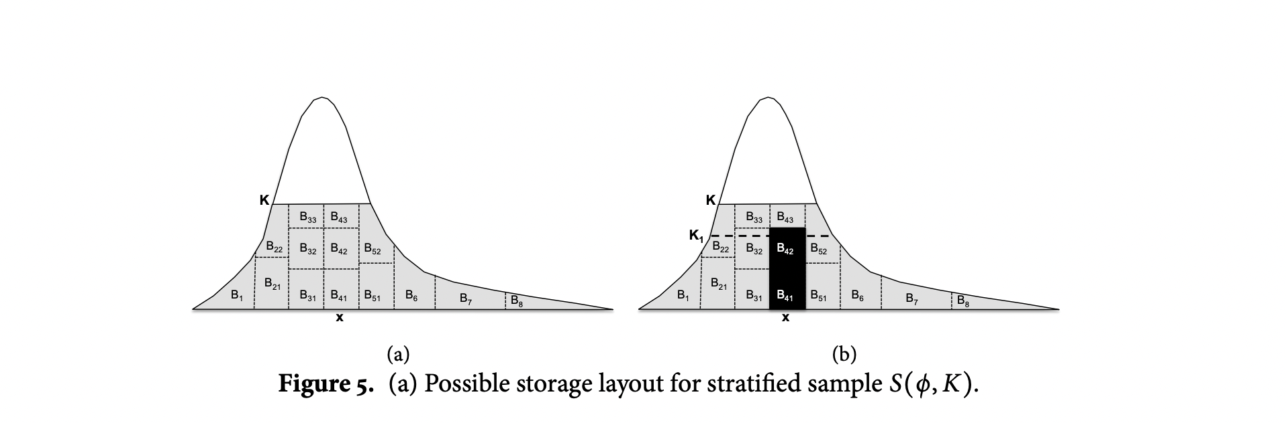
Some Potential Discussion
Proximity-Binning + Bucketing inside bin: two level locality sensitive hashing + universal hashing?

Slide 19
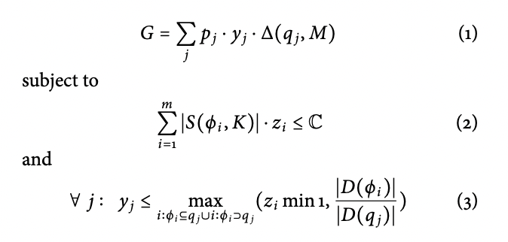
Column Selection - Storage Optimization
Cap operation requires to create bucket of each unique value.
Linear Optimization Problem to maximize the probability of selecting:
Dense Column (fewer distinct values)
Most-Used Column based on prior queries
Constraint on total storage.

Slide 20
Predictable Query: ImMens
Data Cube: d-dimensional array. (Pytorch: d-dimensional tensor)
Why predictable query?
Requires specific visualization plan and resolution
Requires Query Structure (Data-cube)

Slide 21
imMense: Binned Aggregation
Visualization has resolution constraint, and any more data points beyond resolution level does not help for accuracy. (Reasoning similar with PFunk-H)
Binning & Precomputation takes space (e.g Hashing): Dense representation of the data. (Similar with Blink-DB)

Slide 22
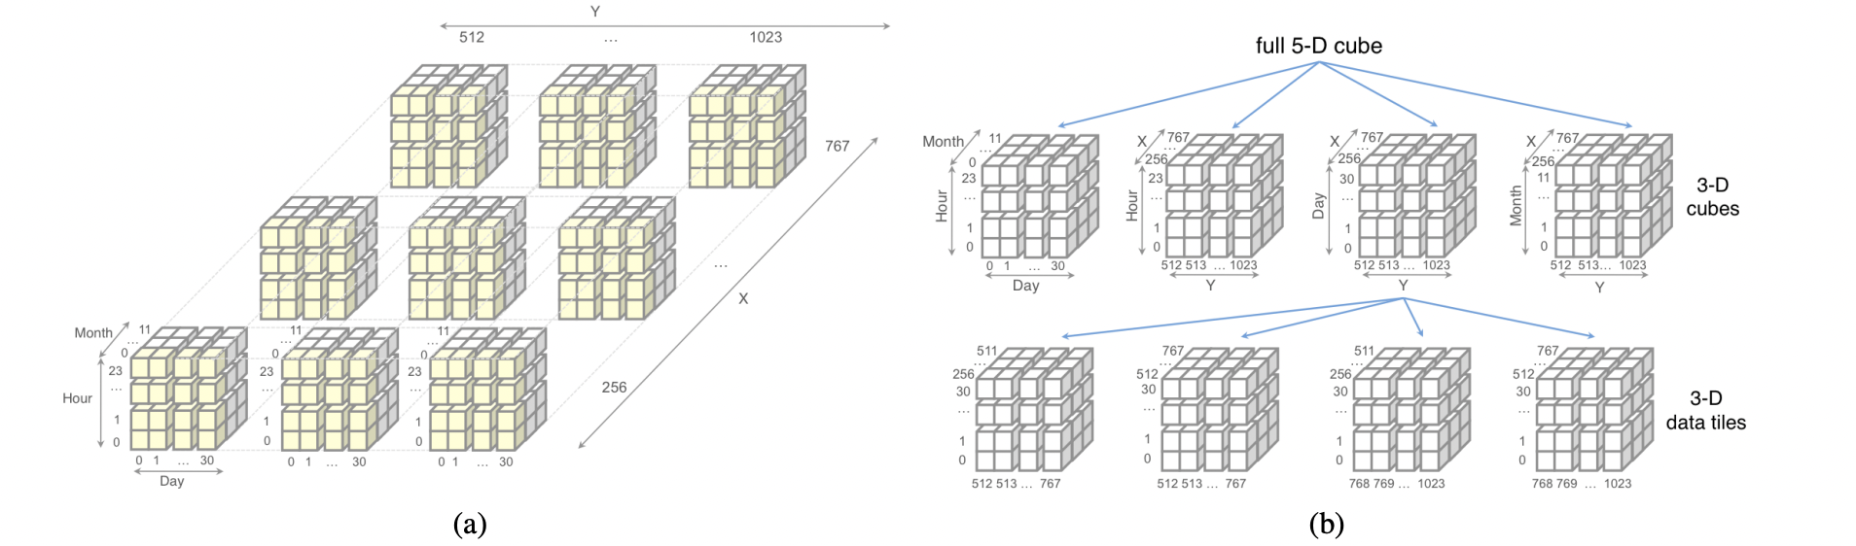
Datacube (cap dimension + precompute the other)

Slide 23
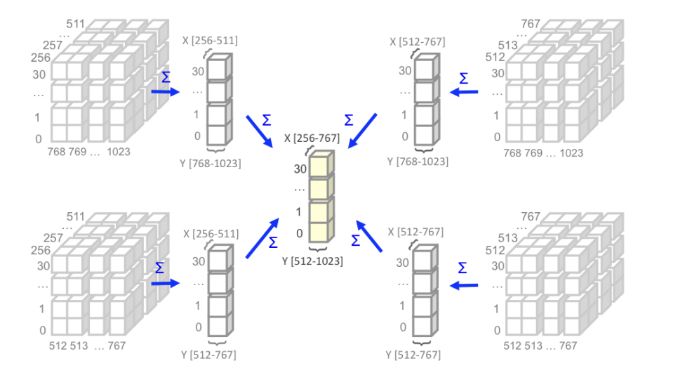
Precompute Data-Tile:
If the query structure is known, then the aggregate function can be precomputed:

Slide 24
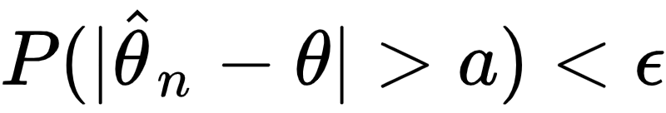
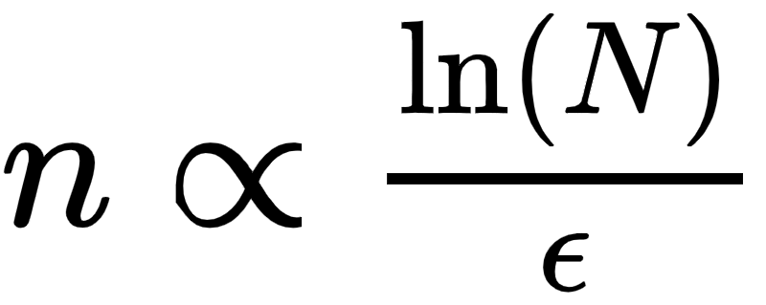
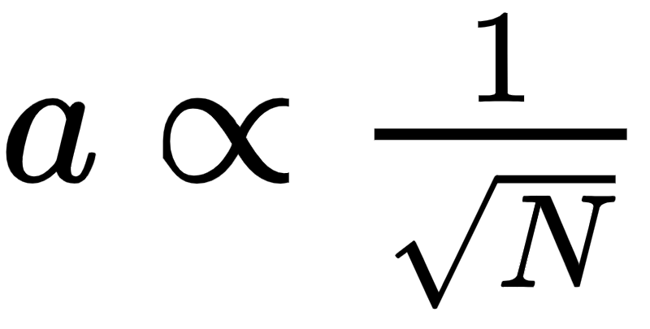
Theoretical Evaluation
With high probability, the confidence interval of the sample statistics is close to the exact parameter:
Usually for a successful data reduction:
Sample size is linear/sublinear function of the database size and the probability epsilon.
“a” is a function of database size that goes to 0
Epsilon is a small probability (such as 1%)

Slide 25
Theoretical Evaluation
Pretty, Pretty Hard….. 17 pages of misery.
Limited Scope, Strong Interpretability.

Slide 26
Empirical Evaluation
Run model on a larrrrrge dataset and see the approximation convergence.
Blink DB: Conviva 17TB.
Wonder Join: TPC-H 1TB

Slide 27
Common Patterns
Mathematical Analysis in paper becomes fewer as the technique become more general (Predictable Query → Predictable Query Predicates → ...)
As the situation becomes more generic, the mathematical analysis becomes more and more challenging.
Parallel processing is mentioned in most papers but with little elaboration.

Slide 28
Discussions
How to approximate for non-SQL database? Objectives?

